Slide 1
INDIA : Size and Location
Location of India on the World Map.
Size of India in comparison with other countries of the world.
India’s neighbouring countries.
Importance of its location at the head of the Indian Ocean.
Indian standard time.

Slide 2
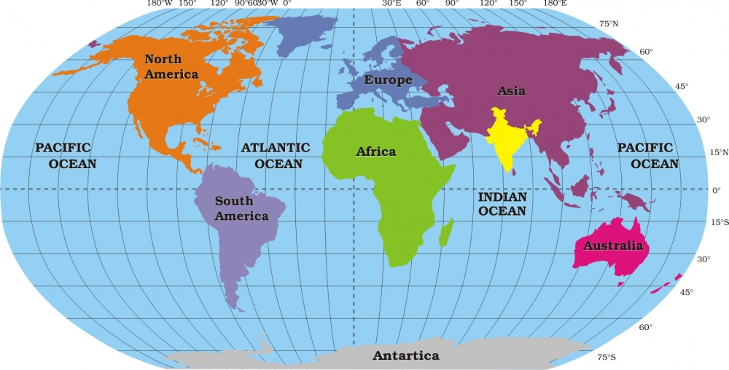
Location of India

Slide 3
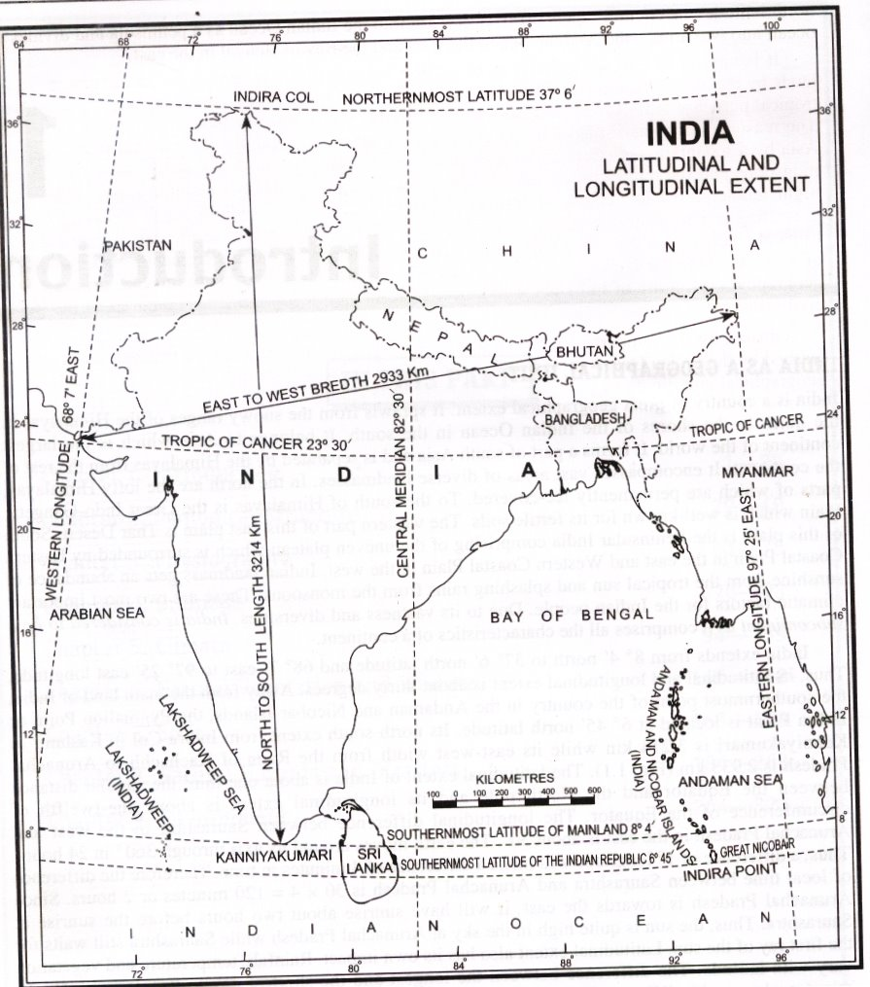
INDIA : Latitudinal and Longitudinal Extent

Slide 4
Points to remember: About India’s Location
Northern Hemisphere
Eastern Hemisphere
Continent : Asia ( South eastern part )
Latitudinal Extent – 8°4’ N to 37°6’ N
Longitudinal Extent – 68°7’ E to 97°25’ E

Slide 5
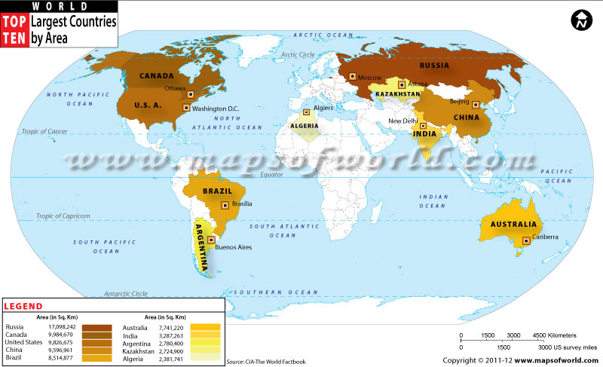
Size of our country

Slide 6
Points to remember: About India’s Size
Seventh largest country in the world
Total area : 32,87,263 km²
North south extent in km : 3,214 km
East west extent in km : 2,933 km
Land Frontier : 15,200 km
Coastline : 7,517 km

Slide 7
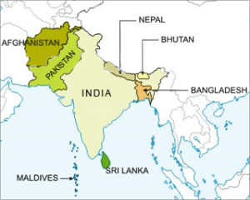
INDIA: Neighbouring countries

Slide 8
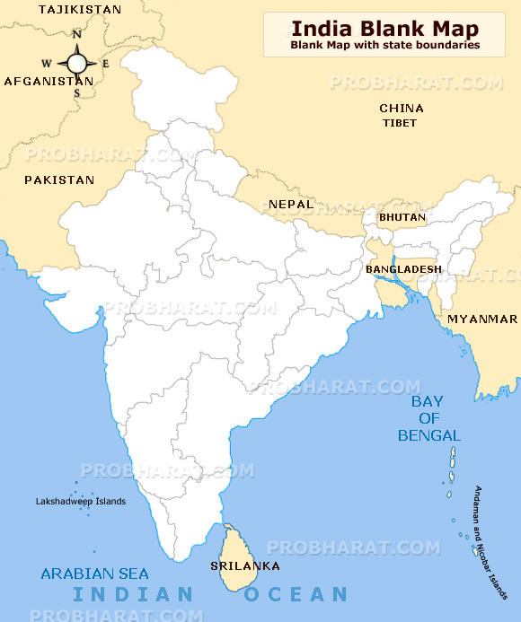

Slide 9
India : Neighbouring Countries
S. no | Neighbouring Country | Direction | Bordering States | Length of border in km
1. | Pakistan | N. West | Gujarat, Rajasthan, Punjab, Jammu & Kashmir. | 3,323 km
2. | Afghanistan | N. West | Jammu & Kashmir | 106 km
3. | China | North | Jammu & Kashmir, Himachal Pradesh, Uttarakhand, Sikkim, Arunachal Pradesh. | 3,488 km
4. | Nepal | North | Uttarakhand, Uttar Pradesh, Bihar, West Bengal, Sikkim. | 1,751 km
5. | Bhutan | North | Sikkim, West Bengal, Assam, Arunachal Pradesh. | 699 km
6. | Myanmar | East | Arunachal Pradesh, Nagaland, Manipur, Mizoram. | 1,643 km
7. | Bangladesh | East | West Bengal, Assam, Meghalaya, Tripura, Mizoram. | 4,096.7 km
8. | Sri lanka | South / SE | --- | ---
9. | Maldives | South/SW | --- | ---

Slide 10
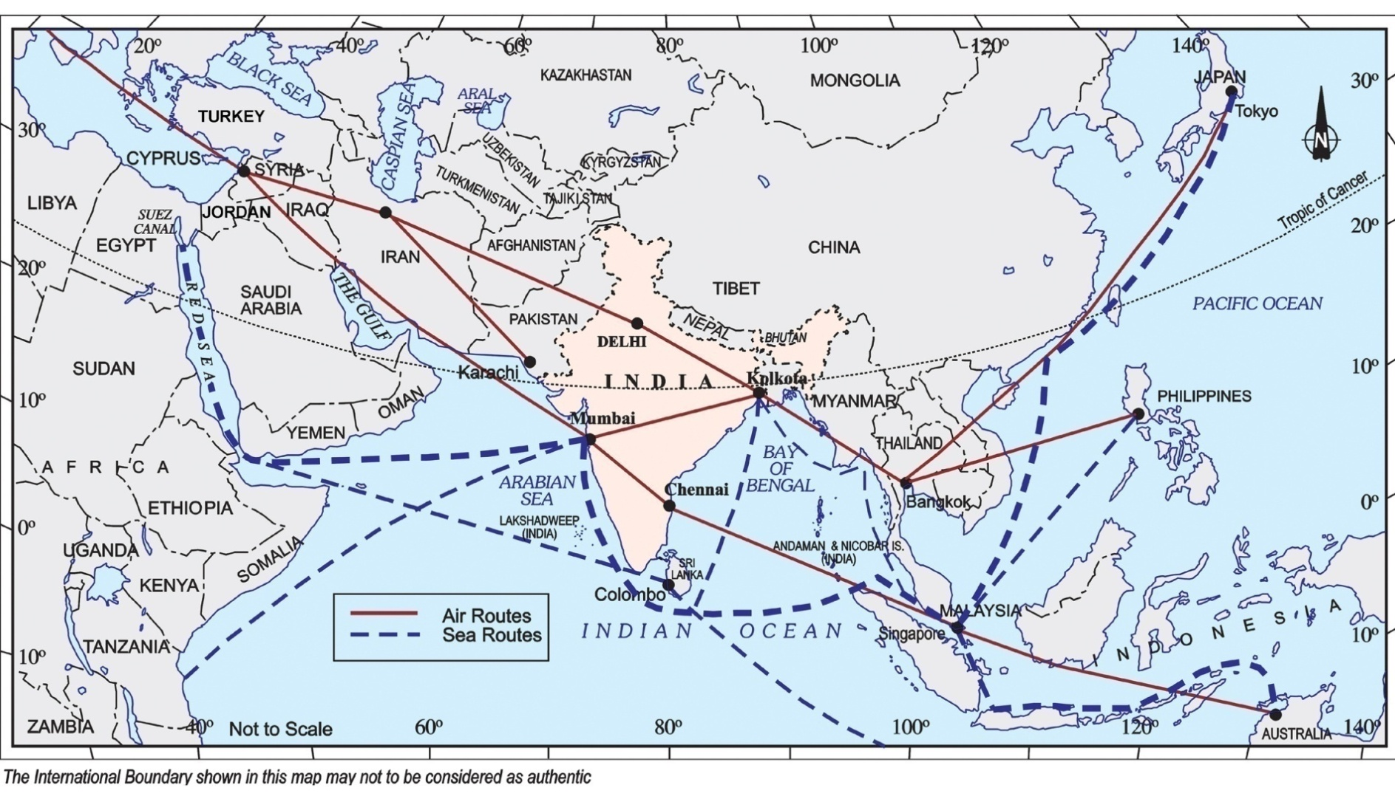
Importance of its location at the head of the Indian Ocean

Slide 11
Points to remember : About importance of India’s location.
Well connected with other important countries of the eastern and western world through the sea routes.
It is on international highway of trade and commerce.
These routes have contributed in the exchange of ideas and commodities since ancient times.
Since the opening of Suez Canal in 1869, India’s distance from Europe has been reduced by 7000 km.
Presence of Indian ocean in the south and Himalayas in the north, is responsible for Monsoonal type of climate in India.

Slide 12
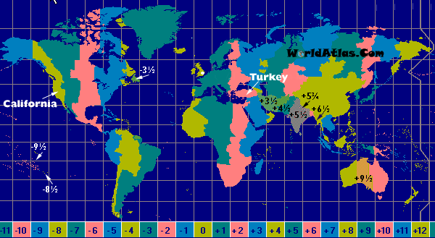
Different Time Zones of the World

Slide 13
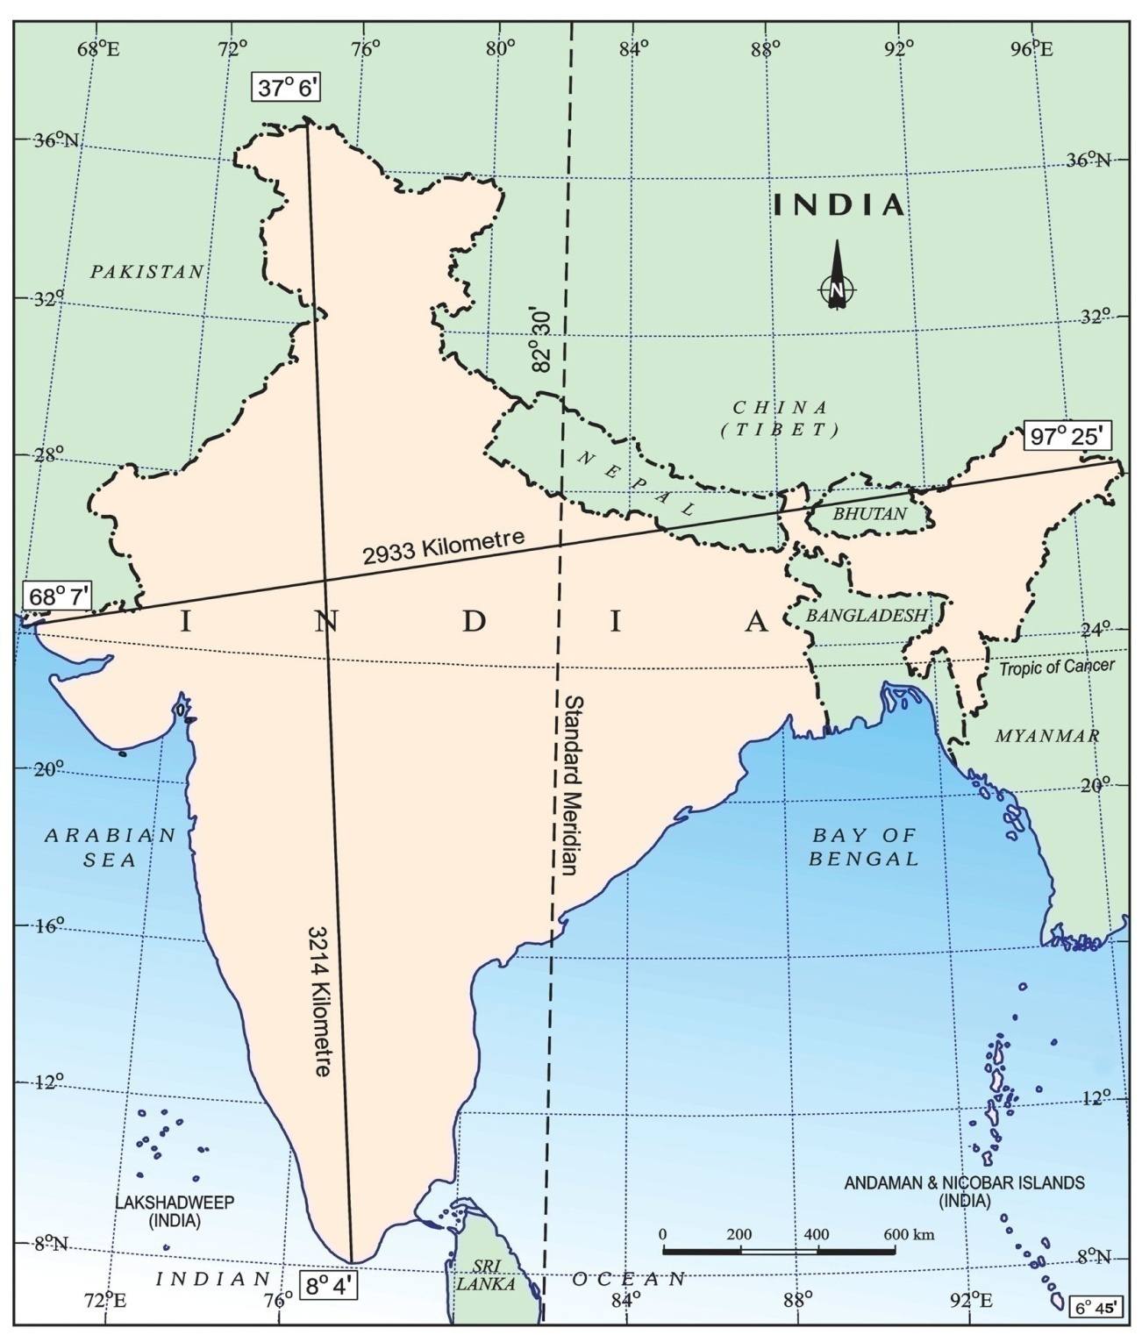
Standard Meridian and Indian Standard Time

Slide 14
Points to remember: About Indian
Standard Time.
Longitudinal extent of the Indian mainland is about 30º.
From Gujarat to Arunachal Pradesh there is time lag of 2 hours.
To avoid any sort of confusion, the whole nation follows the same time which is on The Standard Meridian of India and called as Indian Standard Time.
82º30’E is the Standard Meridian of India which divides India in almost equal vertical halves, passes through Mirzapur in U.P.
Indian Standard Time is 5 ½ hours ahead of GMT.

